Slide 1
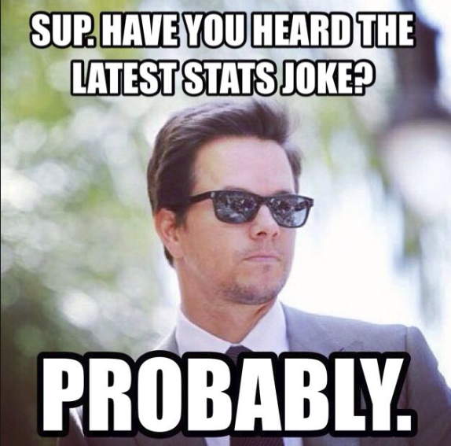
Statistics Analysing Data
Year 10 Mathematics

Slide 2
24
7
30
Topic: Statistics
Date: /10/2018
EQ – How do I assess data quality
There are 2 types of data collected
Primary Data – Collected by the investigator for a specific purpose
Secondary Data – Collected by someone else or for some other purpose
When collecting data it is essential to state the source of the data

Slide 3
24
7
30
Topic: Statistics
Date: /10/2018
EQ – How do I assess data quality
A fair sample is collected from a sample that is like the rest of the population. A biased sample is not typical of the population.
Biased methods and biased questions are likely to influence results in a particular direction. Fair ones are not likely to influence results in a particular way.
Fair questions with fair samples will not give reliable results if the sample is too small. A clear pattern in results of a good survey does suggest that a sample is sufficient. However, conclusions drawn from surveys where frequencies are less than 5 should be regarded with suspicion.

Slide 4
24
7
30
Topic: Statistics
Date: /10/2018
EQ – How do I assess data quality
A fair sample is collected from a sample that is like the rest of the population. A biased sample is not typical of the population.
Biased methods and biased questions are likely to influence results in a particular direction. Fair ones are not likely to influence results in a particular way.
Fair questions with fair samples will not give reliable results if the sample is too small. A clear pattern in results of a good survey does suggest that a sample is sufficient. However, conclusions drawn from surveys where frequencies are less than 5 should be regarded with suspicion.
Non-compliant data is obviously wrong, like someone’s age being 164.
Outliers are data items that are a long way from the rest of the data, but that could be correct.

Slide 5
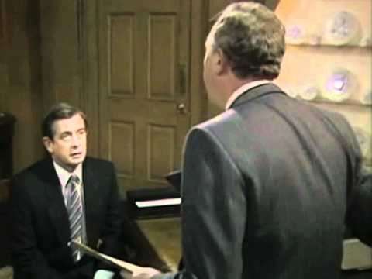
https://youtu.be/G0ZZJXw4MTA

Slide 6
24
7
30
Topic: Statistics
Date: /10/2018
EQ – How do I assess data quality
You will now be assigned a number of 1-4. Each person will have to go and take the notes for a common survey error. In your expert groups you will read the notes, underline the important parts and summarise it. You will then come back to your group as the expert on your type of error, and explain it to the rest of your group. By the end of this you should have notes for the following errors:
The “Leading question”
The “Loaded question”
The “Absolute question”
The “Inaccurate scales”
Once finished you can stick these in your notebooks

Slide 7
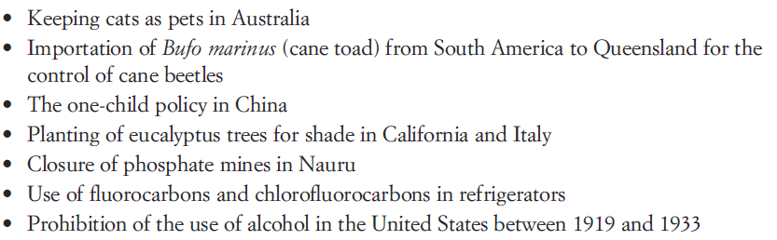
24
7
30
Topic: Statistics
Date: /10/2018
EQ – How do I assess data quality
In the last lesson we saw that misunderstood statistics could lead to unintended consequences, e.g. prevent shark attacks by banning ice cream sales.
Working in groups of 3-4 consider what the unintended consequences for these actions could be / have been
Notes:
Only do this activity if there is time

